Slide 1
E-Commerce Platform
Database
CS27 – BIT
Group 12 Members:
.DEMBELE Gaethan Khaled
·DOUAMBA Niddata Sidonie
·GADIERE Houzéimatou Farida
·KABORE Karelle Aurelie 2e Jumelle
·NANA Eleonore Wendyam Prisca
.OUEDRAOGO Aminata
March 2026

Slide 2
Scenario & Objective
Project Objective
Key Skills Covered
Design and implement a complete relational database to manage a modern e-commerce platform.
Data manipulation (CRUD)
Table relationships (FK)
SQL reporting & aggregates
Included Modules:
Normalization (1NF → 3NF)
Customers
Products
Referential integrity
Categories
Orders
Payments

Slide 3
Database Entities
Entité | Primary Key | Description
Customers | customer_id | Platform customers
Categories | category_id | Product categories
Products | product_id | Available products
Orders | order_id | Orders placed by customers
Order_Items | order_item_id | Line items within each order
Payments | payment_id | Payments linked to orders
Entity
Primary Key
Description
Customers
customer_id
Platform customers
Categories
category_id
Product categories
Products
product_id
Available products
Orders
order_id
Orders placed by customers
Order_Items
order_item_id
Line items within each order
Payments
payment_id
Payments linked to orders

Slide 4
Entity Relationships
1:N
Customers → Orders
A customer can place multiple orders
1:N
Orders → Order_Items
An order contains multiple products
1:N
Products → Order_Items
A product can appear in multiple orders
1:N
Categories → Products
A category contains multiple products
1:1
Orders → Payments
An order has a single unique payment
💡 LEFT JOIN:
Allows viewing all customers even if they have never placed an order.

Slide 5
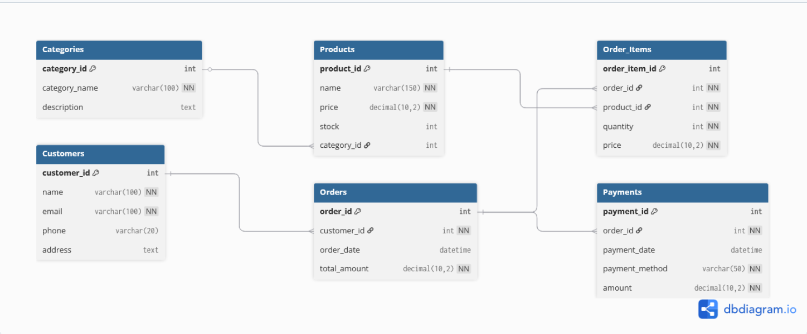
ERD Diagram
[ Insert PNG exported from dbdiagram.io here ]
📌 This diagram shows all entities, primary keys, foreign keys, and the relationships between them.

Slide 6
Database Normalization
BEFORE (Unnormalized)
AFTER (3NF)
❌ Data redundancies
1NF
Each cell holds an atomic value
❌ Insertion anomalies
2NF
Remove partial dependencies
❌ Update anomalies
3NF
Remove transitive dependencies
❌ Deletion anomalies
❌ Single large table
Result: Customers, Products, Orders,
Order_Items, Payments and Categories tables
❌ Transitive dependencies
Customers
Products
Orders
Order_Items
Payments
Categories

Slide 7
SELECT Queries
01
Products with price > $100
02
TOP 5 Best-Sellers
03
Total Revenue by Payment Method
SELECT name, price
FROM Products
WHERE price > 100;
SELECT p.name, SUM(oi.quantity) AS total_sold
FROM Products p
JOIN Order_Items oi ON p.product_id = oi.product_id
GROUP BY p.name
ORDER BY total_sold DESC LIMIT 5;
SELECT payment_method,
SUM(amount) AS total_revenue
FROM Payments
GROUP BY payment_method;

Slide 8
UPDATE / DELETE & Referential Integrity
UPDATE (3 queries)
UPDATE Products SET price = 749.99 WHERE product_id = 1;
UPDATE Products SET stock = stock + 100 WHERE product_id = 2;
UPDATE Customers SET name = 'Updated Customer' WHERE customer_id = 3;
DELETE (2 queries)
DELETE FROM Customers WHERE customer_id = 10;
DELETE FROM Orders WHERE order_id = 9;
⚠️ FK Violation: Cannot delete a customer with linked orders → referential integrity enforced by MySQL.

Slide 9
Aggregate Functions & Reports
COUNT
AVG
SUM
MAX
MIN
Number of customers or orders
Average product price
Total revenue
Most expensive order
Lowest price
Available Reports
Customers with more than 1 order
Total spending per customer
Monthly revenue report
Products with stock < 50 units

Slide 10
Complex SQL Query Explanation
SQL
complex_query.sql
JOIN
Combines rows from Customers and Orders tables using the shared customer_id key.
SELECT
c.name,
COUNT(o.order_id)
FROM
GROUP BY
Customers c
Groups the result set by each customer's name to aggregate their orders.
JOIN
Orders o
ON c.customer_id = o.customer_id
COUNT()
GROUP BY
Counts the number of orders placed by each individual customer.
c.name
HAVING
COUNT(o.order_id) > 1;
HAVING
Filters grouped results — only keeps customers with more than 1 order.

Slide 11
Conclusion
The database system is fully functional
🎯 What We Learned
🗄️
Database Design
All entities and relationships are correctly implemented
Entities, PKs, FKs, schemas
📐
Normalization
Data is consistent and normalized
1NF, 2NF, 3NF applied
SQL queries allow efficient data retrieval
💻
SQL Queries
SELECT, JOIN, GROUP BY, HAVING
The system simulates a real e-commerce platform
🔒
Data Management & Integrity
Constraints, referential integrity
Each member must explain at least 1 query and 1 part of the database.

